Slide 1
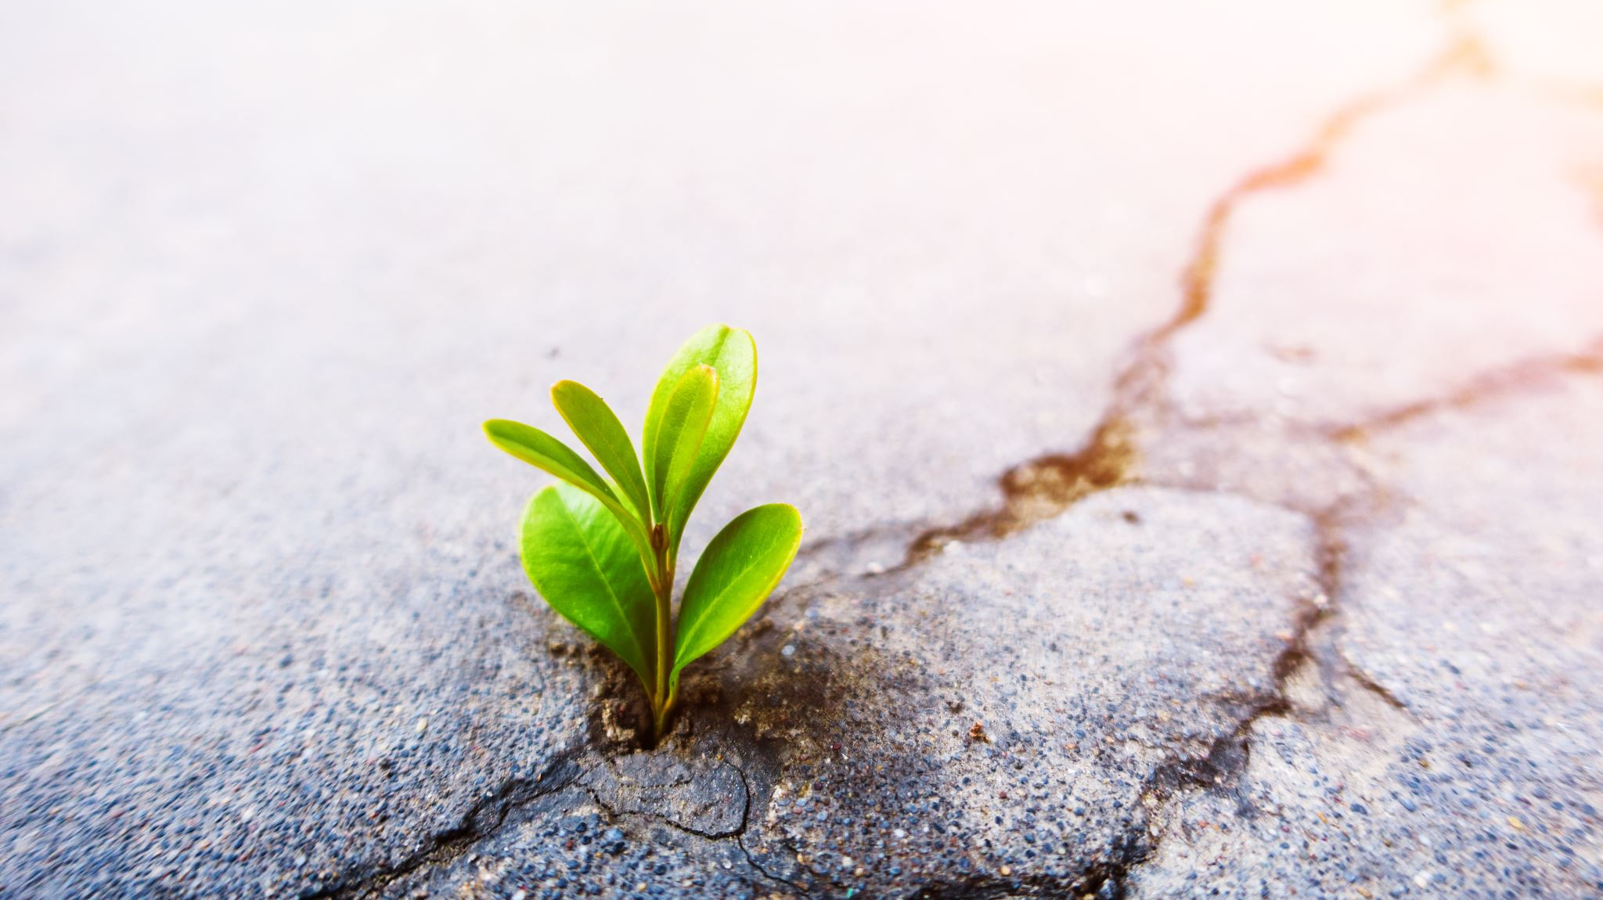
Unit-3 Meaning and Importance of Summer Programs
By-Dr. Meena Sharma

Slide 2
Meaning

Slide 3
Purpose

Slide 4
Importance

Slide 9
Thank You
Stay Home
Stay Safe

